Slide 1
INFO 341 Security vs. Security Theatre
By
Bob Larson

Slide 2
Plan for this Session
Security Theater
Nothing Sells Like Fear
The 9/11 Impact
Four Powerful Drivers of Fear
Threats, Vulnerabilities and Risk
Questions to Ask
Evaluate Any Security Measure

Slide 3
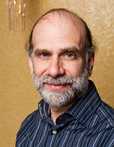
Security Theater
Bruce Schneier
Any action that makes others feel safer and more willing to engage in some activity
While not actually reducing the risk associated with that activity
Security is both a feeling and a reality
Propensity for security theater comes from the interplay between the public and its leaders
When people are scared, they need something done that will make them feel safe, even if it doesn't truly make them safer
Politicians naturally want to do something in response to crisis, even if that something doesn't make any sense

Slide 4
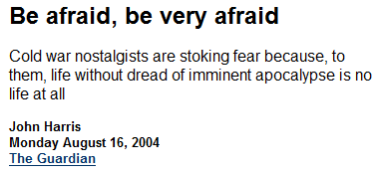
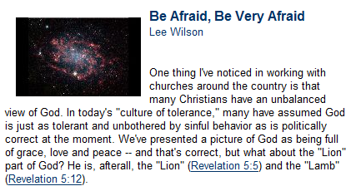

Nothing Sells Like Fear
Be afraid, be very afraid
Ostensibly, a warning that something dangerous is imminent
Origin: The 1986 horror film, "The Fly"

Slide 5
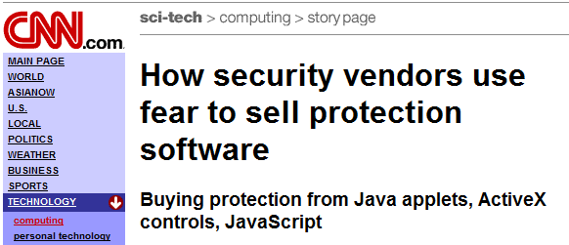
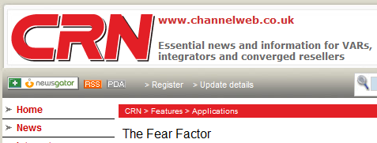
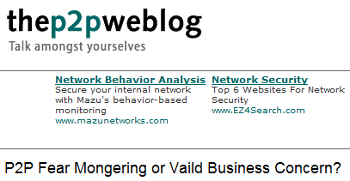
Fear as a Marketing Strategy

Slide 6
The 9/11 Impact
Before 2001, security companies generated most of the fear of being hacked on the Internet
After the 9/11 terrorist attacks, prophets of doom appeared at every corner, issuing dire warnings of enormous financial losses
The U.S. government, raised the fear factor by creating the National Strategy to Secure Cyberspace, a list of ''policy initiatives'' issued by the Department of Homeland Security
The document isn't law
It doesn't contain any mandates to government agencies
It has lots of recommendations and all sorts of processes
It is in the end a list of suggested best practices
Preliminary drafts
Included strong words about wireless insecurity (Removed at the request of the wireless industry)
Suggested ISPs provide all their users with personal firewalls (Removed at the request of the ISP industry)
It had predecessors
The Clinton Administration’s "National Plan for Information Systems Protection.“
Both the GAO and the OMB have published cyber-strategy documents
Unfortunately, plans don't secure anything – action does

Slide 7
Four Powerful Drivers of Fear
Rare cataclysmic losses are more frightening
Than commonplace lesser losses
Things out of your control are more frightening
Than things within your control
Unfamiliar things are more frightening
Than things that are familiar
Things you don't need are more frightening
Than things you need
by Fred Cohen “The Management of Fear”

Slide 8
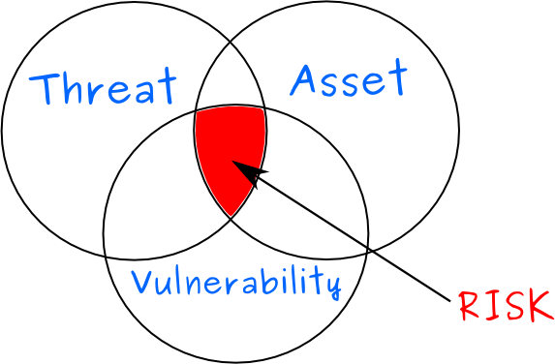
Threats, Vulnerabilities and Risk
Threats
Something bad or harmful
Vulnerabilities
Susceptible to threat, attack or harm
Without adequate protection
Risks
Chance of vulnerability happening
Statistical odds

Slide 9
Questions to Ask
Threats
What is the threat?
Is the threat real?
Vulnerabilities
Am I vulnerable to the threat(s)?
Risks
What are my chances of being impacted?
How can I mitigate the risks?

Slide 10
Health Related Example
Threats
Malaria is a real disease that can kill.
Vulnerabilities
As a human you are vulnerable.
Risks
As long as you live in North America the risk is very low or non-existent.
If you travel to a malaria zone, there are medications you can take to reduce risk.

Slide 11
Evaluate Any Security Measure
What problem does it solve?
How well does it solve the problem?
What new problems does it add?
What are the economic and social costs?
Given the above, is it worth the costs?

Slide 12
Perceived Risk vs. Actual Risk
People exaggerate spectacular but rare risks and downplay common risks
People have trouble estimating risks for anything not exactly like their own normal situation
Personified risks are perceived to be greater than anonymous risks
People underestimate risks they willingly take and overestimate risks in situations they can’t control
People overestimate risks that are being talked about and remain an object of public scrutiny
We over-react to intentional actions and under-react to accidents, abstract events, and natural phenomena
We over-react to immediate threats and under-react to long-term threats
We under-react to changes that occur slowly and over time
We over-react to things that offend our morals

Slide 13
Fin…

